Slide 1


SCRAPING , ANALYSING AND VISUALIZING YOUTUBE TRENDING CHANNELS

Slide 2

1
5
Abstract
Experimental setup
Technologies / Libraries Used
Datasets
Results table / Screenshots
Results comparison with other approaches
2
Introduction
Motivation for work
Real-World Applications
6
Conclusions
3
Related works/Existing works
OVERVIEW
7
Related Works & their limitations
Research Gaps Identified
Future Scope / Directions
4
8
Proposed Method
References
Flowchart
Explanation of each component
Algorithm

Slide 3
1
ABSTRACT
Analysis of structured data has been tremendous success in the past. However, large scale of an unstructured data have been analysed in the form of video format remains a challenging area. The project utilizes the YouTube Data API (Application Programming Interface) which allows the applications or websites to incorporate functions in which they are used by YouTube application to fetch and view the information. The Google Developers Console which is used to generate an unique access key which is further required to fetch the data from YouTube public channel. Process the data and finally visualized. This project extracts the meaningful output of which can be used by the management for analysis, these methodologies helpful for business intelligence.

Slide 4
INTRODUCTION
2
MOTIVATION FOR THE WORK
Youtube is one of the world's largest video sharing platform where videos are uploading continuosly by million's of users. Therefore the importance of youtube is successively increasing for the industry and research community day by day. Youtube video details such as likes,comments are a great way for business to get insights about the customers understanding, customer preferences and needs enable business to improve and customize their products and services.

Slide 5
02
Youtube recommendation system
1
E-Learning
2
Opinion mining
3
2.REAL WORLD APPLICATIONS

Slide 6
3
RELATED WORKS/EXISTING WORKS

Slide 7
1.RELATED WORKS AND THEIR LIMITATIONS
Youtube Scrapping
Allows you to crawl YouTube search results and extract data such as video hashtags,
titles, descriptions, video ID, channel ID, the number of views, etc.
LIMITATION:
Youtube scrapping is extracting the statistics of the channels but not assigning
the rankings to the channels.
Youtube Channel Ranking
Youtube channels ranking is giving ranks to the youtube channels based on maximum subscribers,views and likes etc.
LIMITATIONS:
Extraction of videos from channels and analysis of video statistics have not been done for ranked channels

Slide 8
4
PROPOSED METHOD
Logo

Slide 9
GHHGTYY
GHHGTYY
GHHGTYY
GHHGTYY
Ranking & Visualiz- -ation of channels based on subscribers and views
Collection of youtube channel IDs
Generation of API key from Google Developer Console
Scraping the statistics of each channel
GHHGTYY
GHHGTYY
Extracting&Visualizing the each playlist statistics of the popular channels
Extracting the playlist ids of the popular channels
Extracting statistics of videos in each playlist id
FLOWCHART

Slide 10
2. EXPLANATION OF EACH COMPONENT
Few well known youtube channel ids are collected by inspecting the channel source code and
stored in a csv file
An account is created in Google Developer Console and generated the API key.
Accessing the youtube service by using build method from googleapiclient.discovery. By requesting
the youtube service we can get the response as a json format which contains the entire details of that
particular channel that we have passed. From that it extracted the required statistics and a dataframe is
created from it.
Ranking the channels based upon the no.of.subscribers and no.of viewers and represented the
comparisons in the form of visualizations using seaborn library.
Two channels are selected for analysis based upon the highest no.of subscribers and viewers, each
playlist from those channels are extracted.
Statistics of each playlist are collected into dataframe. Finally these statistics are visualized.
Again videos in each playlist are extracted and percentage of no.of videos of particular type are
represented using piecharts.

Slide 11
STEP 1 : Start
STEP 2 : Collection of Channel ids from source code of channels into csv file.
STEP 3 : Generating the youtube API Key from Google developer console.
STEP 4 : Importing the libraries :
Pandas,Seaborn,Matplotlib,googleapiclient.discovery
STEP 5 : Creating the youtube service by calling build method of googleapiclient library.
youtube : = build('youtube','v3',developerKey=api_key)
STEP 6 : Giving channels list as an argument for the youtube service object method and it is stored in request variable. It returns the details of given channels in the csv file as JSON format by executing this request. And store it in response variable.
response : = request.execute()
STEP 7 : Extract the required statistics of the channels from the reponse variable. Convert it into Dataframe.
STEP 8 : Make some analysis on this data, draw conclusions and visualise them.
STEP 9 : Repeat the process from STEP 5 for details of playlists and videos also.
STEP 10 : End
A
L
G
O
R
I
T
H
M

Slide 12
5
EXPERIMENTAL SETUP
Logo

Slide 13
1
2
Libraries used
Datasets
Pandas
Seaborn
googleapiclient.discovery
Matplotlib
Channel ids

Slide 14
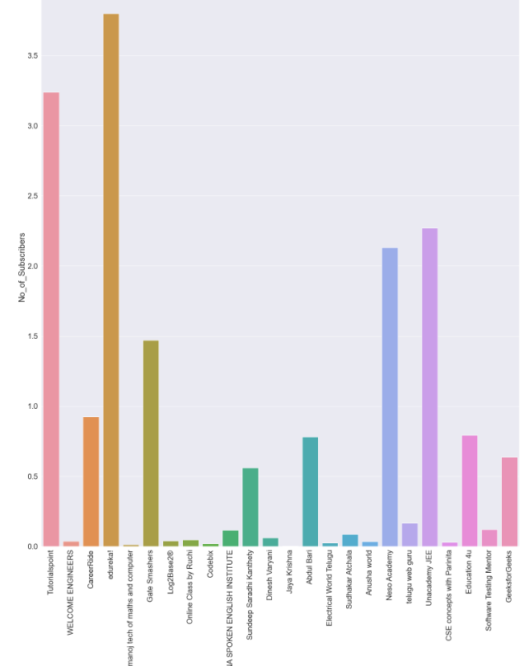
3
Results/Screenshots
Visualization based on numbr of subscribers

Slide 15
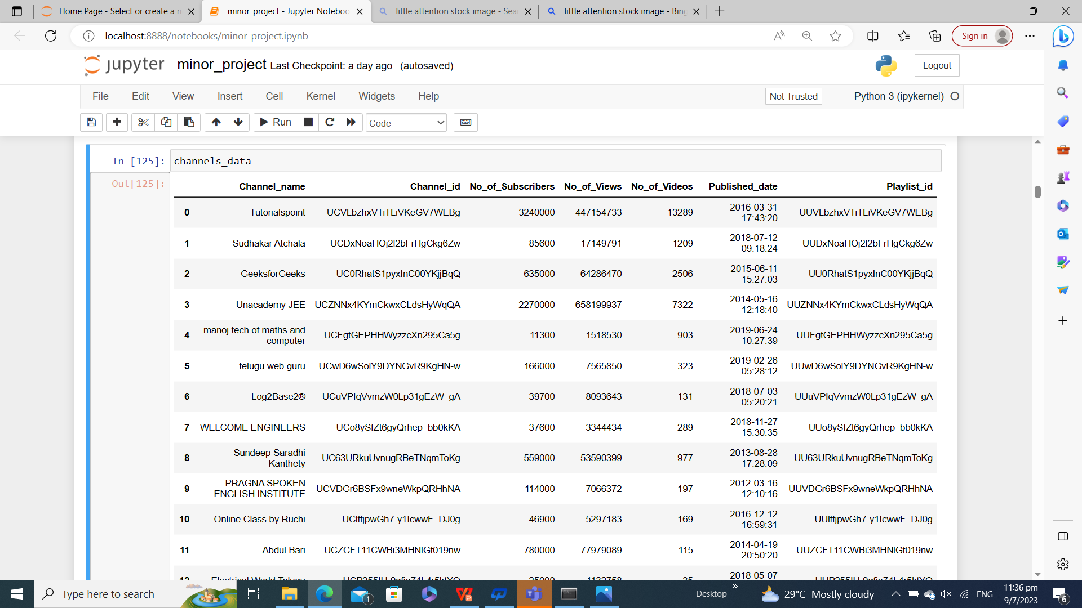
Dataframe for Channel wise statistics

Slide 16
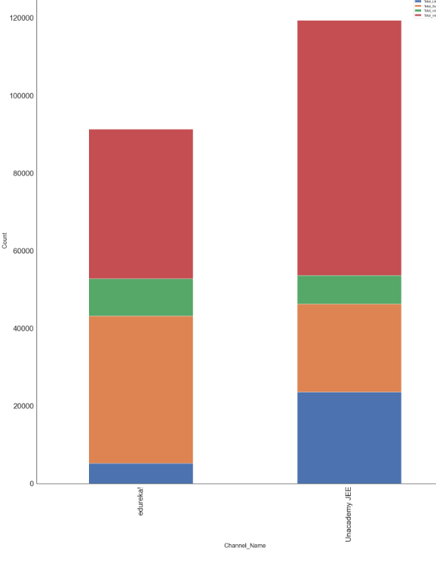
Likes
videos
views
subscribers
Comparision between maximum subscribers and views channels

Slide 17
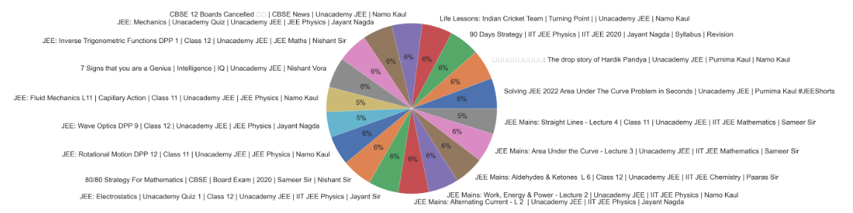
Percentage of videos in the Playlists of popular channel

Slide 18
6
CONCLUSIONS

Slide 19

Channel with less no.of subscribers have more no.of views
when compared to channel with more no.of subscribers
In our input Edureka! channel has higher no.of subscribers
Unacademy JEE channel got more no.o.f views
Edureka! has less no.of viewers than Unacademy JEE
Subscribers count is more important than viewers count so
Edureka is the best one among these

Slide 20
7
FUTURE SCOPE
Sentiment Analysis can be applied for comments extracted for the channel/playlist/video etc.
Youtubers can use this analysis for their channel improvement.
Recommendation of youtube videos based on users interest in social media platforms.

Slide 21
8
REFERENCES
https://www.researchgate.net/publication/355333357_Scraping_and_Analysing_YouTube_Trending_Videos_for_BI
Youtube API Documentation : https://developers.google.com/youtube/v3/docs/

Slide 22
THANK YOU

